Slide 1
Analyzing H1B DATA USING HADOOP ECOSYSTEM
Presented by :
Name : PRAJAKTA VITTHAL SHINDE
Student ID : S171107500166
Center: Pune Deccan

Slide 2
objective
The H1B is an employment-based, non-immigrant visa category for temporary foreign workers in the United States.
We will be performing analysis on the H1B visa applicants between the years 2011-2016.Analyzing h1b data to provide flexibility to make another vise policy.

Slide 3
Big data
Big data is a term that describes the large volume of data – both structured and unstructured – that inundates a business on a day-to-day basis.
But it’s not the amount of data that’s important. It’s what organizations do with the data that matters.
Big data can be analyzed for insights that lead to better decisions and strategic business moves.

Slide 4
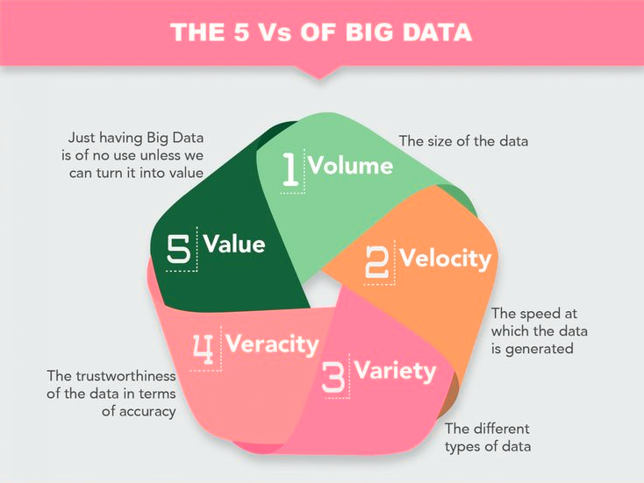

Slide 5

Hadoop Ecosystem

Slide 6
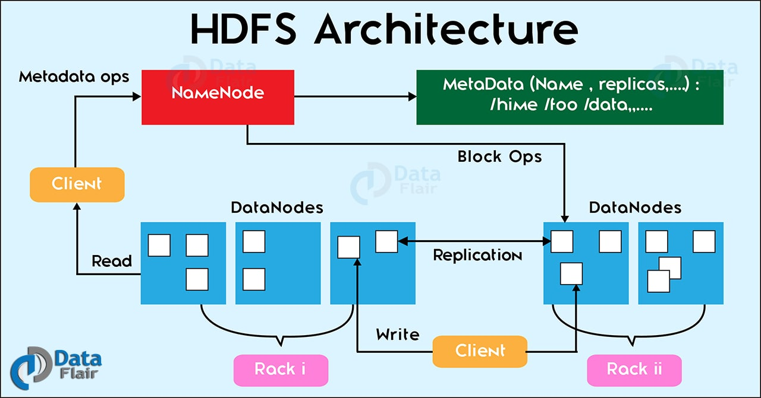

Slide 7
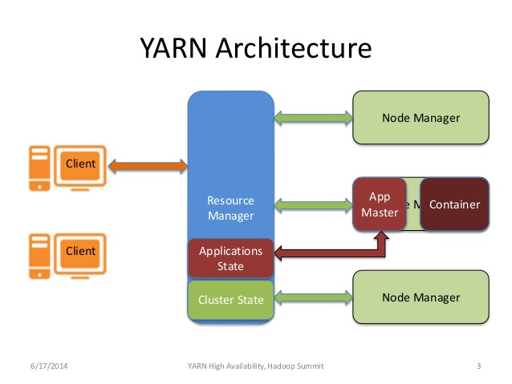

Slide 8
Advantages of Hadoop
Scalable : Hadoop is a highly scalable storage platform, because it can store and distribute very large data sets across hundreds of inexpensive servers that operate in parallel
2. Cost effective :Hadoop also offers a cost effective storage solution for businesses' exploding Data sets.
Hadoop, on the other hand, is designed as a scale-out architecture that can affordably store all of a company’s data for later use.
3. Flexible : Hadoop enables businesses to easily access new data sources and tap into different types of data (both structured and unstructured) to generate value from that data.
4. Fast : Hadoop's unique storage method is based on a distributed file system that basically 'maps' data wherever it is located on a cluster.
If you're dealing with large volumes of unstructured data, Hadoop is able to efficiently process terabytes of data in just minutes, and petabytes in hours.
5. Resilient to failure : A key advantage of using Hadoop is its fault tolerance. When data is sent to an individual node, that data is also replicated to other nodes in the cluster, which means that in the event of failure

Slide 9
Technology used
MapReduce : a parallel processing software framework. It is comprised of two steps. Map step is a master node that takes input and partitions them into smaller sub-problems and then distributes them to worker nodes. After the map step has taken place, the master node takes the answer to all of the sub-problems and combines them to produce output.
Hive : a data warehousing and SQL like query language that presents the data in the form of tables. Hive programming is similar to data Warehousing
Pig : a platform for manipulating data stored in HDFS and that includes a compiler for map reduce programs and high level language called Pig Latin.it provides a way to perform data extractions, transformation and loading and basic analysis without having to write Map Reduce programs
Sqoop : a connection and transfer mechanism that moves the data between Hadoop and relational databases

Slide 10
Analyzing Factors
We will be performing analysis on the H1B visa applicants between the years 2011-2016. After analyzing the data, we can derive the following facts.
1. a) Is the number of petitions with Data Engineer job title increasing over time?
b) Find top 5 job titles who are having highest avg growth in applications.[ALL]
2. a) Which part of the US has the most Data Engineer jobs for each year?
b) find top 5 locations in the US who have got certified visa for each year.[certified]
3. Which industry(SOC_NAME) has the most number of Data Scientist positions?
[certified]
4. Which top 5 employers file the most petitions each year? - Case Status - ALL

Slide 11
Analyzing Factors
5. Find the most popular top 10 job positions for H1B visa applications for each year?
a) for all the applications
b) for only certified applications.
6. Find the percentage and the count of each case status on total applications for each year. Create a line graph depicting the pattern of All the cases over the period of time.
7. Create a bar graph to depict the number of applications for each year [All]
8. Find the average Prevailing Wage for each Job for each Year (take part time and full time separate). Arrange the output in descending order - [Certified and Certified Withdrawn.]
9. Which are the employers along with the number of petitions who have the success rate more than 70% in petitions. (total petitions filed 1000 OR more than 1000) ?
10. Which are the job positions along with the number of petitions which have the success rate more than 70% in petitions (total petitions filed 1000 OR more than 1000)?
11. Export result for question no 10 to MySql database.

Slide 12
1. a) Is the number of petitions with Data Engineer job title increasing over time?
Technology used : HIVE
Solution : petitions with Data Engineer job title increasing over time year by year.

Slide 13
1. b) Find top 5 job titles who are having highest avg growth in applications.[ALL]
Technology Used : PIG
Solution :
TOP 5 JOB_TITLE | AVG GROWTH
SENIOR SYSTEMS ANALYST JC | 60, 4255.4644
SOFTWARE DEVELOPER | 23480.59
PROJECT MANAGER 3,3233.3335
SYSTEMS ANALYST JC 65,2984.8809
MODULE LEAD, 2917.112

Slide 14
2. a) Which part of the US has the most Data Engineer jobs for each year?
WORKSITE | NO OF APPLICATION | YEAR
SEATTLE, WASHINGTON | 20 | 2011
SEATTLE, WASHINGTON | 30.00 | 2012
SEATTLE, WASHINGTON | 46 | 2013
SEATTLE, WASHINGTON | 45 | 2014
SEATTLE, WASHINGTON | 61 | 2015
SEATTLE, WASHINGTON | 128 | 2016
Technology Used : PIG
Solution :

Slide 15
2. b) find top 5 locations in the US who have got certified visa for each year.[certified]
Technology Used : HIVE
Solution :

Slide 16
3. Which industry(SOC_NAME) has the most number of Data Scientist positions? [certified]
Technology Used : MAPREDUCE
Solution :
INDUSTRY | NO OF JOB
STATISTICIANS | 572
COMPUTER AND INFORMATION RESEARCH SCIENTISTS | 419
OPERATIONS RESEARCH ANALYSTS | 380
COMPUTER AND INFORMATION RESEARCH SCIENTISTS | 181
COMPUTER OCCUPATIONS ALL OTHER | 160

Slide 17
4. Which top 5 employers file the most petitions each year? - Case Status - ALL
Technology Used : MAPREDUCE
Solution :

Slide 18
5. Find the most popular top 10 job positions for H1B visa applications for each year? a) for all the applications.
JOB TITLE | YEAR | NO OF APPLICATION
PROGRAMMER ANALYST | 2016 | 53743
SOFTWARE ENGINEER | 2016 | 30668
SOFTWARE DEVELOPER | 2016 | 14041
SYSTEMS ANALYST | 2016 | 12314
COMPUTER PROGRAMMER | 2016 | 11668
BUSINESS ANALYST | 2016 | 9167
COMPUTER SYSTEMS ANALYST | 2016 | 6900
SENIOR SOFTWARE ENGINEER | 2016 | 6439
DEVELOPER | 2016 | 6084
TECHNOLOGY LEAD - US | 2016 | 5410
Technology Used : HIVE
Solution :

Slide 19
5. Find the most popular top 10 job positions for H1B visa applications for each year? b) for only certified applications.
Technology Used : HIVE
Solution :
JOB_TITLE | YEAR | YEAR | YEAR | YEAR | YEAR | YEAR
 | 2011 | 2012 | 2013 | 2014 | 2015 | 2016
PROGRAMMER ANALYST | 28806 | 29226 | 29906 | 38625 | 48203 | 52320
SOFTWARE ENGINEER | 11224 | 12273 | 12973 | 17278 | 23352 | 32451
COMPUTER PROGRAMMER | 8038 | 8483 | 10202 | 13796 | 12971 | 13524
SYSTEMS ANALYST | 7850 | 8399 | 7850 | 9161 | 11498 | 12876
BUSINESS ANALYST | 3444 | 4144 | 7809 | 6529 | 9343 | 10203
COMPUTER SYSTEMS ANALYST | 3152 | 4084 | 7641 | 6473 | 8238 | 9546
ASSISTANT PROFESSOR | 3050 | 3420 | 4993 | 6204 | 7919 | 8305
PHYSICAL THERAPIST | 2911 | 3290 | 4554 | 5055 | 7234 | 8610
SENIOR SOFTWARE ENGINEER | 2595 | 3284 | 4316 | 4911 | 7009 | 8125
SENIOR CONSULTANT | 2585 | 3033 | 3996 | 4535 | 5324 | 6254

Slide 20
6. Find the percentage and the count of each case status on total applications for each year. Create a line graph depicting the pattern of All the cases over the period of time.
Technology Used : MAPREDUCE
Solution :

Slide 21
7. Create a bar graph to depict the number of applications for each year [All]
Technology Used : MAPREDUCE
Solution :

Slide 22
8. Find the average Prevailing Wage for each Job for each Year (take part time and full time separate). Arrange the output in descending order - [Certified and Certified Withdrawn.]
Technology Used : HIVE
Solution :
AVERAGE PREVAILING WAGE | YEAR | Job position
9853122.909 | 2012 | (ASSOCIATE SQA ENGINEER,Y)
9491354 | 2012 | (TEACHER (MATHEMATICS),Y
9422870 | 2012 | (SENIOR AUDIT ASSOCIATE,Y)
9078950 | 2012 | (ELEMENTARY SCHOOL SPANISH TEACHER,Y)
8976796.8 | 2012 | (DATA ADMINISTRATOR,N
8831672.062 | 2012 | (SENIOR FINANCE MANAGER,Y)
8453338.3 | 2012 | (PRINCIPAL ARCHITECT,Y)

Slide 23
9. Which are the employers along with the number of petitions who have the success rate more than 70% in petitions. (total petitions filed 1000 OR more than 1000) ?
JOB_POSITION | NO OF APPLICATION | SUCESSES RATE
INFOSYS LIMITED 99.54055 130592
(ACCENTURE LLP 99.39307 33447
(TATA CONSULTANCY SERVICES LIMITED 99.337204 64726
(HCL AMERICA, INC. 99.26801 22678
(RELIABLE SOFTWARE RESOURCES, INC. 99.14658 1992
(NTT DATA, INC. 99.13251 4611
(ERP ANALYSTS, INC. 99.10364 1785
(PATNI AMERICAS INC. 99.07907 3149
(KFORCE INC. 99.06015 1596
(GENPACT LLC 98.852776 1046
Technology Used : PIG
Solution :

Slide 24
10. Which are the job positions along with the number of petitions which have the success rate more than 70% in petitions (total petitions filed 1000 OR more than 1000)?
Technology Used : PIG
Solution :
JOB_POSITION | NO OF APPLICATION | SUCESSES RATE
COMPUTER PROGRAMMER | 1276 | 100
ASSOCIATE CONSULTANT | 4393 | 99.93
SYSTEMS ENGINEER | 10036 | 99.9
TEST ANALYST | 4928 | 99.81
CONSULTANT | 7426 | 99.81
TECHNOLOGY LEAD | 28350 | 99.8
TECHNICAL TEST LEAD | 5374 | 99.79
TECHNOLOGY ARCHITECT | 4707 | 99.76
(TECHNOLOGY ANALYST | 26055 | 99.76
SENIOR PROJECT MANAGER | 2774 | 99.74

Slide 25
11. Export result for question no 10 to MySql database.
Technology Used : SQOOP
Solution :
1.mysql –u root –p
2. create database h1b_FINAL;
3. use h1b_FINAL
4.CREATE TABLE suc_rate(job_title varchar(100)NOT NULL,total_no_of_appl INT NOT NULL,certifiedANDcertified_withdrwan_count INT NOT NULL,
5.desc suc_rate;
+---------------------------------------+--------------+------+-----+---------+-------+
| field | type | null | key | default | extra |
+---------------------------------------+--------------+------+-----+---------+-------+
| job_title | varchar(100) | no | | null | |
| total_no_of_appl | int(11) | no | | null | |
| certifiedandcertified_withdrwan_count | int(11) | no | | null | |
| success_rate | float | no | | null | |
+---------------------------------------+--------------+------+-----+---------+-------+
6.Start sqoop…..connect to msql>h1b database
sqoop list-tables --connect jdbc:mysql://localhost/h1b --username root --password ‘ROOT'

Slide 26
Conclusion:
Petitions for data engineer job are increasing over time.
Possibility of application getting certified increases every year.
Jobs for Data Science are more In Statistician industries.
Success rate of INFOSYS LIMITED is more .
For System Engineer –US has more success rate.
Sqoop is Usefull when we have data on HDFS that need to be exported into the MySQL tables or vice-versa.
Hive helps in cleaning up data.CSV file can be easily converted into TSV Text file.
For normal group by join and filter based data retrieval ,Pig is very efficient.
MapReduce code written in java makes complex analysis quite easy. Codes required to be written to collects user inputs and performing complex join operations are handled efficiently using this approach.

Slide 27
THANK YOU

